Slide 1
NO Conflict of Interest
TEMPLATE

Slide 2
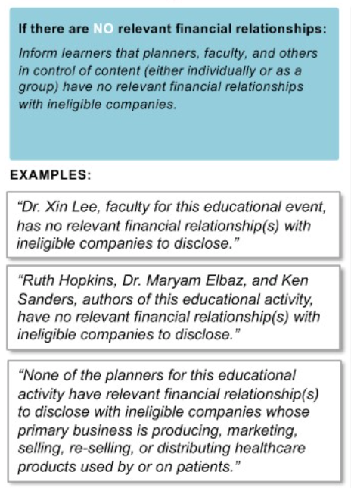
DIRECTIONS PLEASE DELETE POST-READ
Disclosure statements must be made prior to EVERY CME approved learning session
Disclose name(s) of the individuals, name of the ineligible company(ies) with which they have a relevant financial relationship(s), the nature of the relationship(s), and a statement that all relevant financial relationships have been mitigated.
Planner(s)
Faculty/Activity Chairs(s)
Activity Planning Committee Member(s)
Author(s) of learning session content
See last side for new users (QR code to create an account) and contact number for current users to text in for attestation
EXAMPLE:

Slide 3
[Insert Activity Title Here] [Insert Speaker Name Here] [Insert Session Title Here]
CODE:​
XXXXX
Disclosure Statement:
[Insert Name], [Insert Role] for this educational event, has no relevant financial relationship(s) with ineligible companies to disclose.
[Insert Name], [Insert Role] for this educational event, has no relevant financial relationship(s) with ineligible companies to disclose.
[Insert Name], [Insert Role] of this educational activity, has no relevant financial relationship(s) with ineligible companies to disclose.
[Insert credit approval amount] AMA PRA Category 1 Credit™​​
The University of South Carolina School of Medicine Greenville (USCSOMG) designates this live activity for a maximum of [Insert credit approval amount] AMA PRA Category 1 Credits™. Physicians should claim only the credit commensurate with the extent of their participation in the activity.​ ​ The University of South Carolina School of Medicine Greenville is accredited by the Accreditation Council for Continuing Medical Education (ACCME) to provide continuing medical education for physicians.​

Slide 4
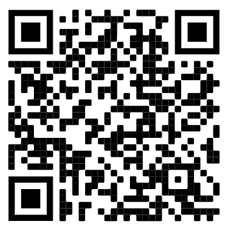
TEXT CODE
XXXXX
Attestation is open for 32 days.
Please contact the CME Team for any attestation issues at CME@prismahealth.org.
New User?
Create an account to attest!
Current Users:
Text in to attest using the
CME Learning Portal
Text-In Contact #:
(864) 362-3332
*Without an account,
text-in attesting will not work

