Slide 1
YES Conflict of Interest
TEMPLATE

Slide 2
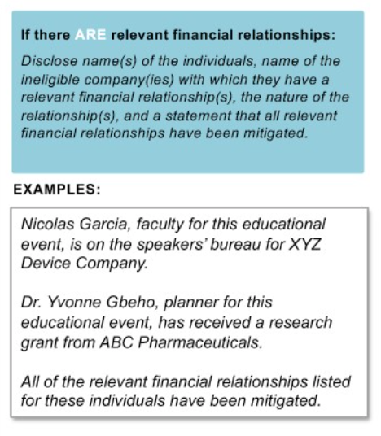
DIRECTIONS (Please delete this slide before adding this template to your presentation.)
Disclosure statements must be made prior to EVERY CME approved learning session
Disclose name(s) of the individuals, name of the ineligible company(ies) with which they have a relevant financial relationship(s), the nature of the relationship(s), and a statement that all relevant financial relationships have been mitigated.
Planner(s)
Faculty/Activity Chairs(s)
Activity Planning Committee Member(s)
Author(s) of learning session content
See last side for new users (QR code to create an account) and contact number for current users to text in for attestation
EXAMPLE:

Slide 3
[Insert Activity Title Here] [Insert Speaker Name Here] [Insert Session Title Here]
CODE:​
XXXXX
Disclosure Statement:
[Insert Name], [Insert Role] for this educational event, is [Insert the Nature of the Financial Relationship] for [Insert Name of the Ineligible Company].
[Insert Name], [Insert Role] for this educational event, is [Insert the Nature of the Financial Relationship] for [Insert Name of the Ineligible Company].
[Insert Name], [Insert Role] for this educational event, is [Insert the Nature of the Financial Relationship] for [Insert Name of the Ineligible Company].
All financial relationships have been mitigated.
[Insert credit approval amount] AMA PRA Category 1 Credit™​​
The University of South Carolina School of Medicine Greenville (USCSOMG) designates this live activity for a maximum of [Insert credit approval amount] AMA PRA Category 1 Credits™. Physicians should claim only the credit commensurate with the extent of their participation in the activity.​ ​ The University of South Carolina School of Medicine Greenville is accredited by the Accreditation Council for Continuing Medical Education (ACCME) to provide continuing medical education for physicians.​

Slide 4
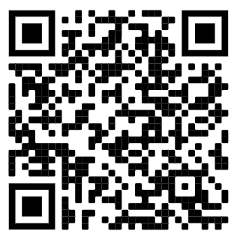
Text-In Code
XXXXX
Attestation is open for 32 days.
Please contact the CME Team for any attestation issues at CME.Upstate@prismahealth.org.
New to EthosCE?
Create an account to attest!
Current EthosCE Users:
Text this code (not case sensitive) to 864-362-3332. You should receive an immediate response confirming your attendance.
*Without an account,
text-in attesting will not work.

