Slide 1

Frame of Reference and Shared Mental Models
Monica Newton, DO MPH

Slide 2
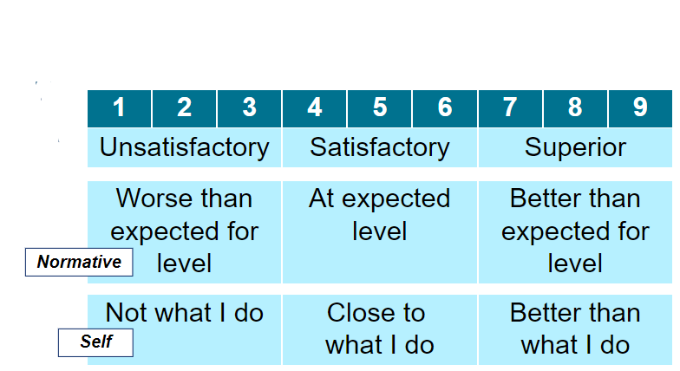
Frame of Reference?
Adapted from Microlearning Understanding Issues of Reliability and Validity
ACGME – Direct Observation Toolkit
Notes:
You were given a 9-pt rating scale with the anchors of unsatisfactory, satisfactory and superior – but no additional explanation (as with most forms, they assume the rater knows)
In the absence of guidance, most faculty use these scales normatively, selecting a rating based on what they think they should be at their level of training ( a resident that is better than expected gets a higher score).
Faculty might also use self as their frame of reference, any issues you see there?
Faculty is not always an expert in every skill we assess, practicing physician skills ae variable

Slide 3
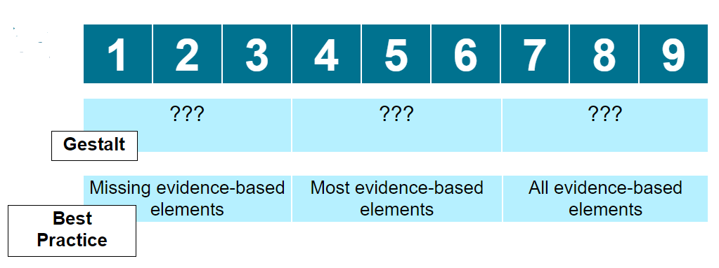
Frame of Reference?
Adapted from Microlearning Understanding Issues of Reliability and Validity
ACGME – Direct Observation Toolkit
Notes:
Sometimes faculty pick based on their gut feeling – that might make it difficult to break down why the learner received that rating – making it hard to give specific, actionable feedback
Least likely to use best practice as a frame of reference – however there is thought that shifting from normative scales to something grounded in trainee competence using evidence based metrics will produce results that are more aligned. And there are ways to help us determine these evidence based findings – part of it is the medicine, but part of it is more structured.
Hand out evidence-based frameworks – history taking and shared patient decision making

Slide 4
Frame of Reference?
Adapted from Microlearning Understanding Issues of Reliability and Validity
ACGME – Direct Observation Toolkit
Notes:
You were given a 9-pt rating scale with the anchors of unsatisfactory, satisfactory and superior – but no additional explanation (as with most forms, they assume the rater knows)
In the absence of guidance, most faculty use these scales normatively, selecting a rating based on what they think they should be at their level of training ( a resident that is better than expected gets a higher score).
Faculty might also use self as their frame of reference, any issues you see there?
Faculty is not always an expert in every skill we assess, practicing physician skills ae variable

Slide 5
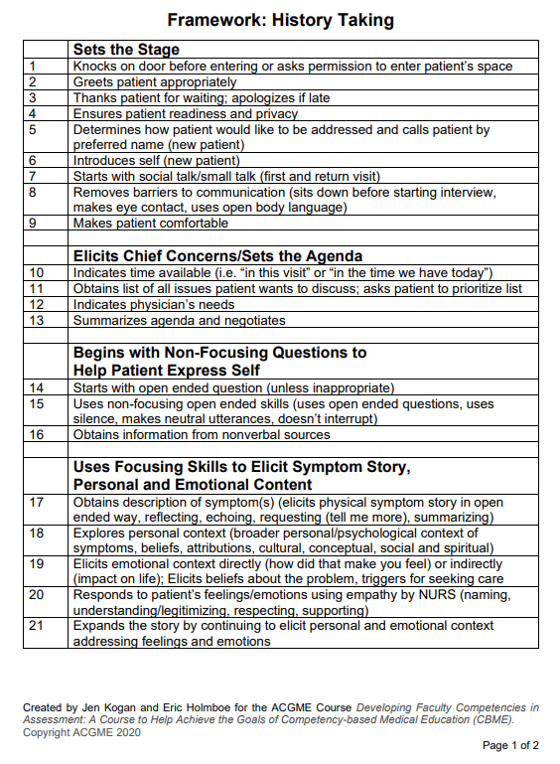
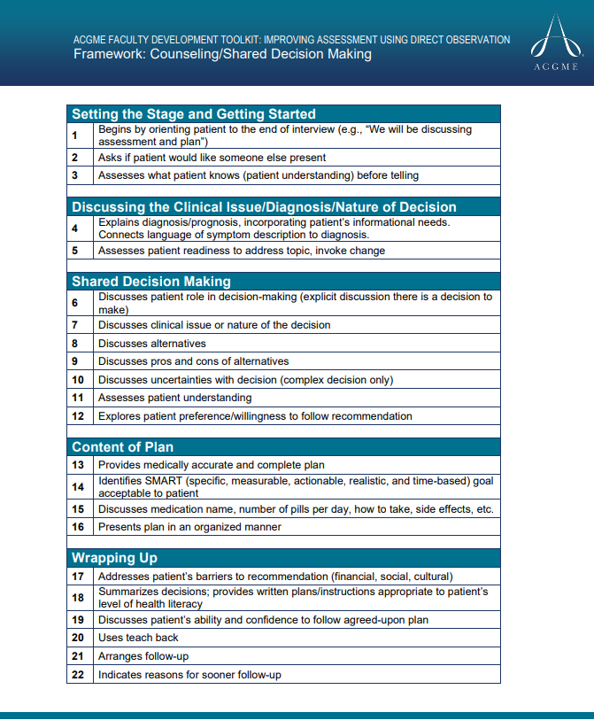
Tools to create an evidence-based frame of reference

Slide 6

“Think something that nobody has thought yet, while looking at something that everyone has seen”
Arthur Schopenhauer- “Philosopher of Pessimism”

Slide 7
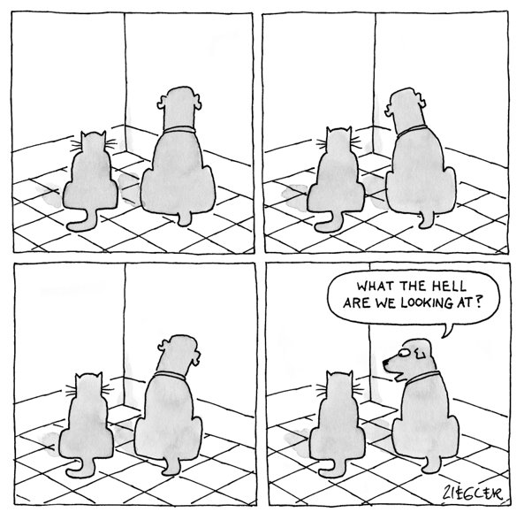
It helps to know what you are looking for!

Slide 8

Increasing reliability
Notes:
As we stated before, the form is not the key, it is the faculty – and their shared understanding of the goals
Faculty development is key – performance dimension training and creating a shared mental model
Performance dimension training educates raters on the specific dimensions used to evaluate trainees before the observation is begun. Understanding each dimension can then guide rater observation and subsequent evaluation. Each dimension is clearly defined, and examples of actions and behaviors associated with the dimension are given.
Vergis A, Leung C, Roberston R. Rater Training in Medical Education: A Scoping Review. Cureus. 2020;12(11):e11363. Published 2020 Nov 6.

Slide 9
Performance Dimension Training
Identify specific dimensions of a competency
in behavioral terms
Discuss the criteria and qualifications required for each dimension of that competency
Compare with an evidenced-based framework
Develop a SHARED MENTAL MODEL
Holmboe et al. 2010

Slide 10
Shared Mental Model
Notion that the team will perform better if they have a shared understanding of the task to be performed and the role of the team member.
Jonker, C.M., van Riemsdijk, M.B., Vermeulen, B. (2011). Shared Mental Models. In: De Vos, M., Fornara, N., Pitt, J.V., Vouros, G. (eds) Coordination, Organizations, Institutions, and Norms in Agent Systems VI. COIN 2010. Lecture Notes in Computer Science(), vol 6541. Springer, Berlin, Heidelberg. https://doi.org/10.1007/978-3-642-21268-0

Slide 11
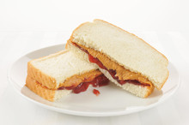
Creating a shared mental model
Lets Practice!
How do you make a Peanut Butter and Jelly sandwich?
Place two pieces of bread on plate
Spread peanut butter on one piece
Spread jam on other piece
Put together
Cut in half (optional)
Wash hands

Slide 12
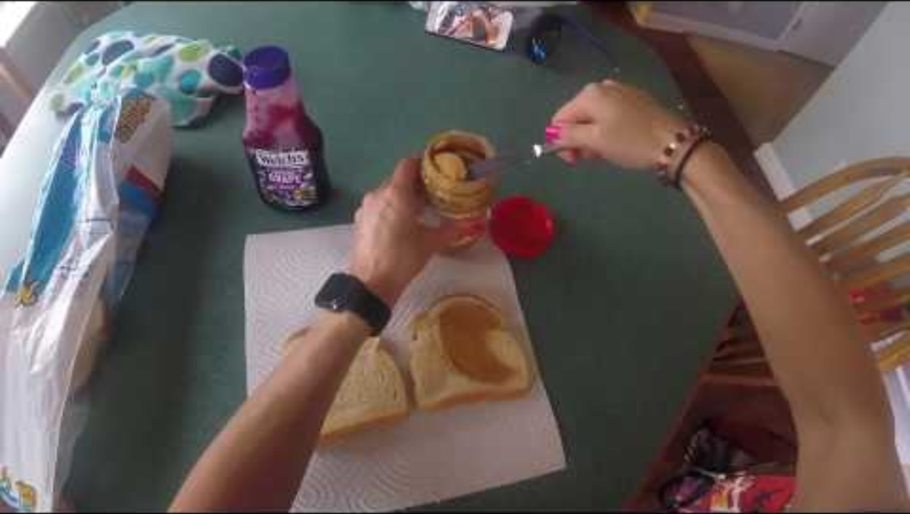
Creating a shared mental model
How do you make a Peanut Butter and Jelly sandwich?
Place two pieces of bread on plate
Spread peanut butter on one piece
Spread jam on the other piece
Put together
Cut in half (optional)
Wash hands

Slide 13
How to Create a Shared Mental Model
Set aside Faculty Development time
Have the group make a list of observations they would like to make
Choose one
Then have group make a list of steps they expect to see to complete the skill
(Share with group a validated tool- if one available)
Compare your list to the validated tool- tweaking it as needed (streamline or add)
Pilot it (perhaps on a standardized video as a group)
Discuss time to implement
Discuss tracking of resident progress
GYN exam/Pelvic exam | GYN exam
Osteopathic Structural Exam | Osteopathic Exam
Shared Decision Making
New Medication | shared decision making
Pain Management | shared decision making
Goals of Care | shared decision making
Contraception Counseling | shared decision making
Informed Consent | informed consent
Other | shared decision making
Difficult Conversations
Bad News | SPIKES model
End of Life | SPIKES model
Kogan JR, Holmboe ES, Hauer KE. Tools for direct observation and assessment of clinical skills of medical trainees: a systematic review. JAMA. 2009 Sep 23;302(12):1316-26. doi: 10.1001/jama.2009.1365. PMID: 19773567.

Slide 14
Our Direct Observation Toolkit
Spreadsheet of skills- and which framework to use
History (ACGME)
Physical (Stanford 25)
Shared decision making (ACGME)
Difficult conversations (SPIKES)
Counseling for Behavior Change (Univ. MN- Change that Matters framework)
Frameworks available (paper/clipboard or online teams)
Evaluation (quick and easy)
Tracking tool on Teams so all preceptors can see what needs to be observed

Slide 15
Making tracking and Assessment easier
How to track your Direct Observations
How to use Milestone Elements (behavioral markers) in your Evals to help your CCCs

Slide 16
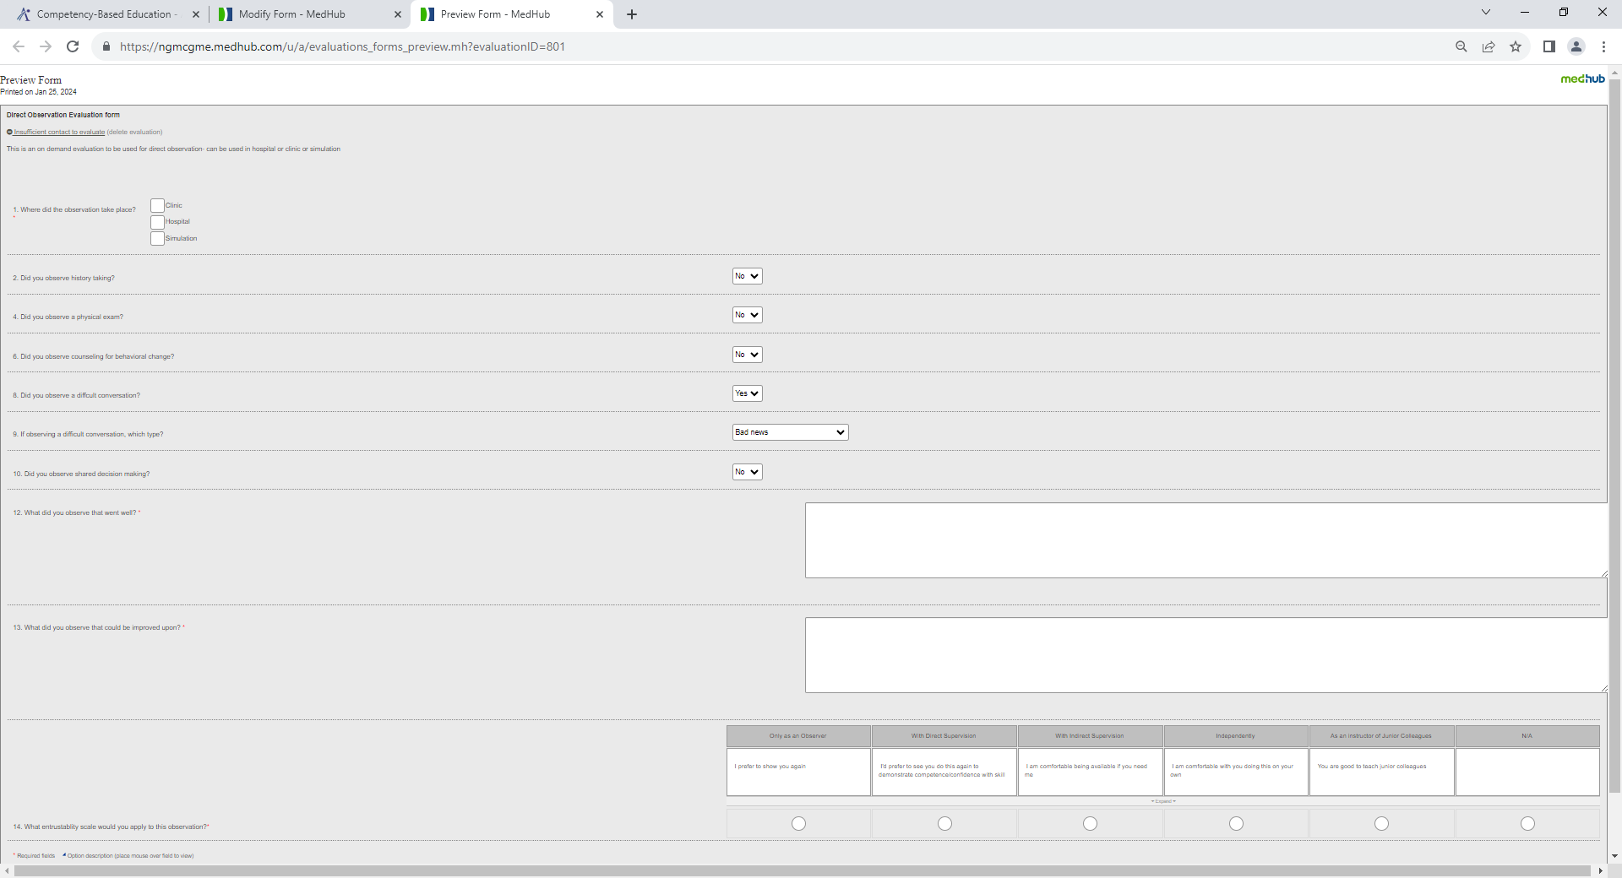
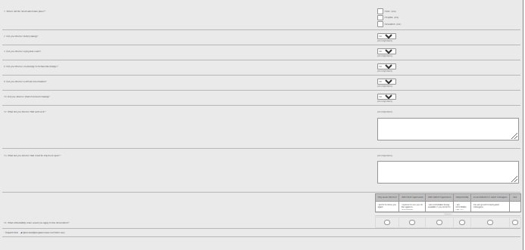
Direct Observation Documentation

Slide 17
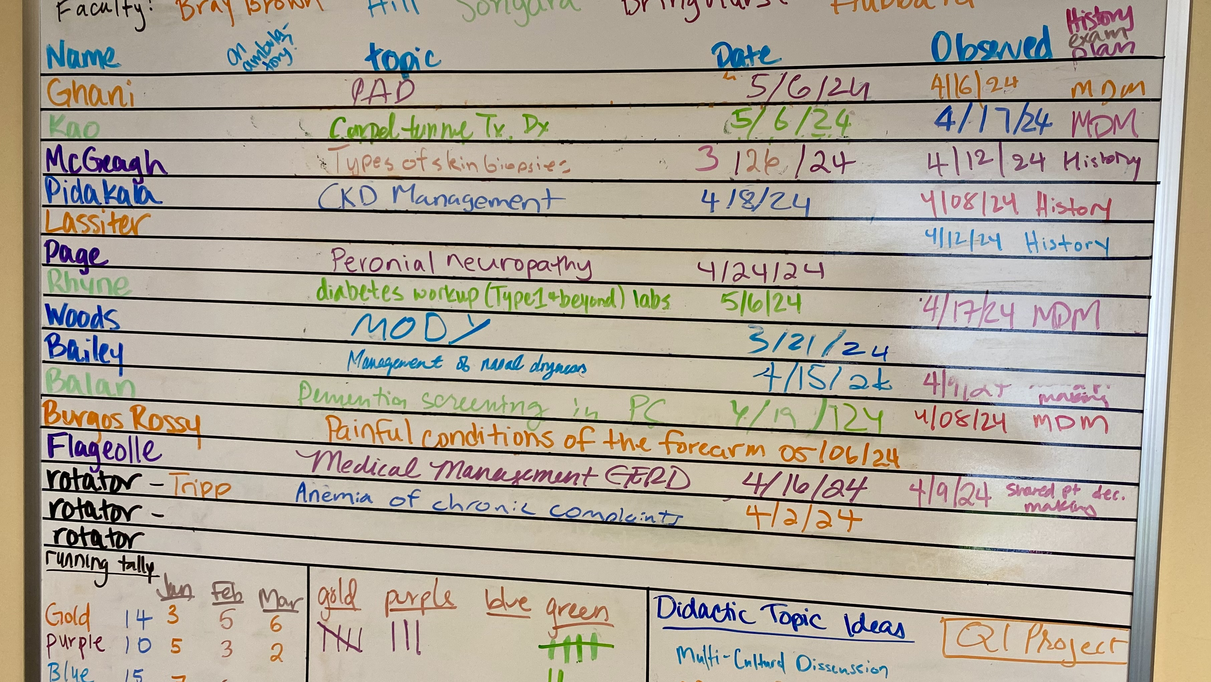

Slide 18
Program Director’s Role
Vision and Strategic Planning
Establish a clear vision for competency-based education
Advocacy and Communication
Curriculum Integration
Actively lead the integration of competencies into the curriculum
Faculty Training and Development
Organize and facilitate faculty development related to competency- based assessments

Slide 19
Success is a moving target
We started Direct Observation in October 2023
The plan is to have 750 done by end of September 2024
In AY 24 we completed 850
In AY 25 we completed 1125 but shy of the 1440 in the Pilot
Success =sustaining the energy!

