Slide 1
Assessment Basics and Multi-Source Feedback
Monica Newton DO and Daniel E Yoder, Jr. MD

Slide 2
Conflicts of Interest
None to report

Slide 3
Objectives
Differentiate key features of common types of assessment methods
Discuss criteria/frameworks to assist in choosing assessment methods
Discuss the end goal of your assessments
Review current evidence for multi-source feedback
Discuss how to use self-assessment more effectively

Slide 4
What is Assessment?
"A systematic process to measure or evaluate the characteristics or performance of individuals, programs or other entities, for purposes of drawing inferences"
Standards for Educational and Psychological Testing 2014

Slide 5
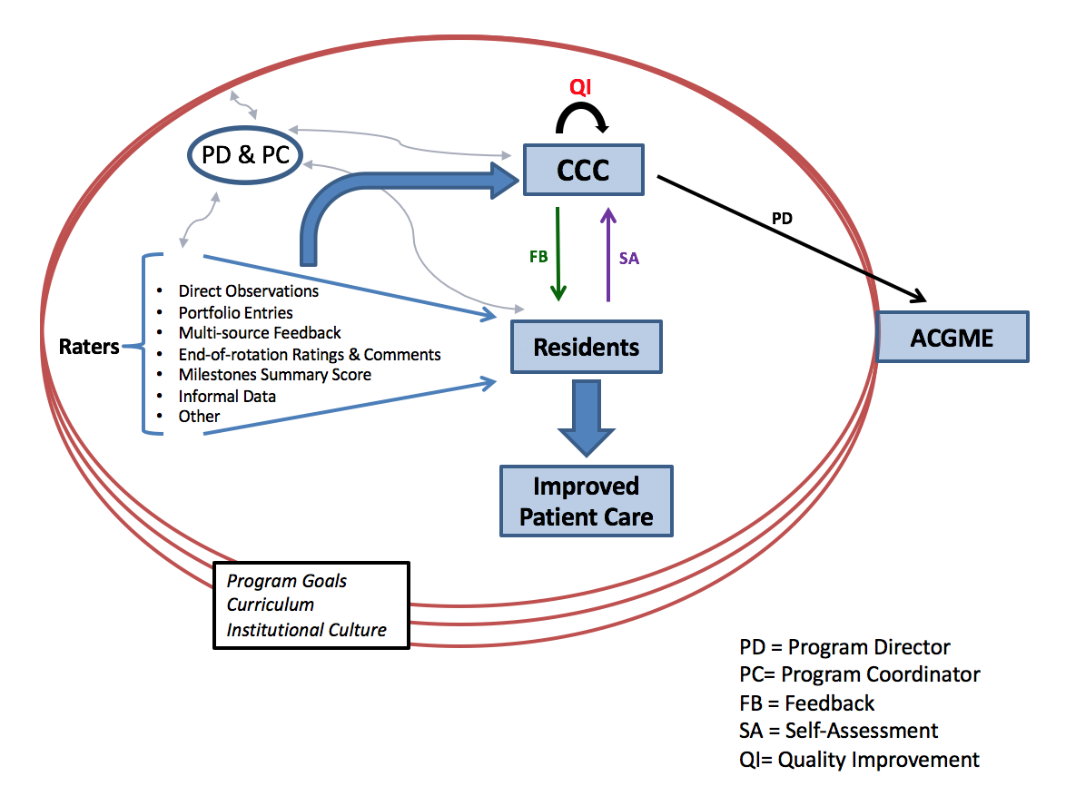
Assessment as a System
Updated from: Ekpenyong et al, A Textbook of Internal Medicine Education Programs 12th ed.

Slide 6
Assessment Questions
What are we assessing our trainees for?
Knowledge? Skills? Attitudes?
“How might we best measure it, and how will we know we are measuring it accurately?”
“What do we hope to achieve by measuring it?”
“How might our measurement activities lead to expenses, logistical hurdles or even unexpected negative outcomes?”
Lineberry M. Assessment in Health Professions Education, 2nd ed.

Slide 7
Assessments
Multiple types and methods
What is your favorite assessment tool?
Who is doing most of the assessment work?
Notes:
I spent over three years trying to design the perfect tools, only to realize they weren’t being used
Who designs assessments in your program
Outreach to the evaluators is the most important part of this process
The goal of this session is to help you think about other places to get feedback for your residents and your program

Slide 8
What Are Your Faculty Assessing?
1:1 patient encounter
Admissions
Clinic visits
Daily rounds
Procedures
Work-day or shift performance
Rotation-based or longitudinal performance

Slide 9
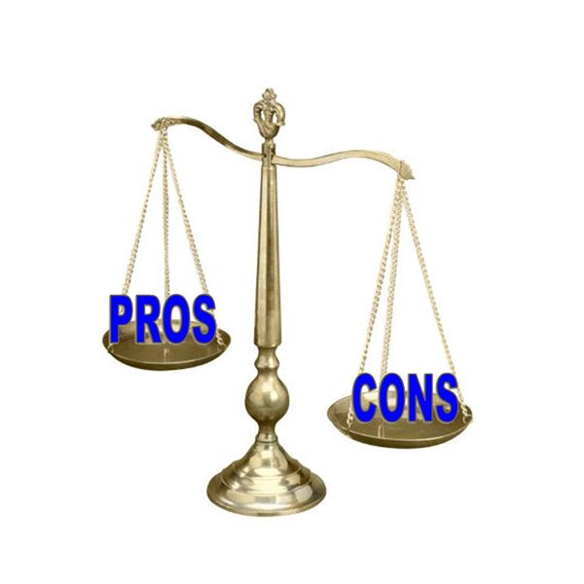
Nothing is Perfect
Notes:
No tool is perfect. Assessment tools do not need to be perfect to provide useful information about the learner
The question is how imperfect is it? Add in example

Slide 10
“Fit for Purpose”
Is it the right tool/method for the competency(ies)?
How will the method/tool help the program assess and provide feedback on professional development?
How does it fit within a program of assessment?

Slide 11
Assessment Methods vs. Tools
Method
Approach used to document and assess clinical performance of trainees
e.g.
Direct observation
Multiple choice questions
Tool
Example of the method
e.g.
Mini-CEX, SEGUE
In-training exam

Slide 12

Miller's Pyramid, Acad Med 1990
Does (action)
Shows How (performance)
Knows How (competence)
Knows
(knowledge)
Performance in Practice
Multi-source feedback
Direct Observation
Work-based assessment is mostly accomplished through the observations and questions of faculty, team members, peers and other co-workers
Standardized Patients
Simulation
Diagnostic Reasoning using clinical vignettes
Oral Exams
Multiple Choice Questions
Notes:
Very important, highlight

Slide 13

Assessing for the Desired Outcome
Does (action)
Shows How (performance)
Knows How (competence)
Knows
(knowledge)
Performance in Practice
Multi-source feedback
Direct Observation
Ability in Action
Standardized Patients
Simulation
Capability
Diagnostic Reasoning using clinical vignettes
Oral Exams
Capacity
Multiple Choice Questions

Slide 14
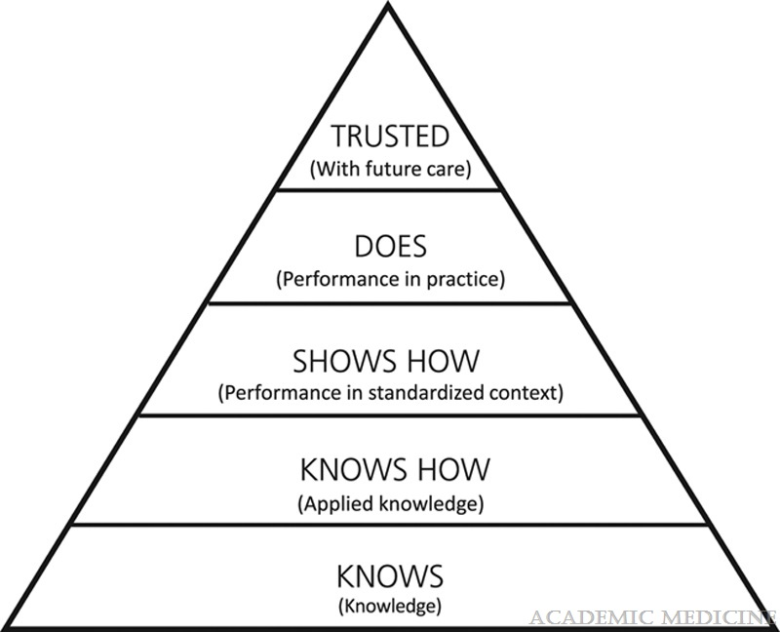
“Extended” Miller’s Pyramid
A new fifth level (“trusted”) reflects the process for reaching the decision to award a learner an attestation of the completion of training, leading to a medical license or specialty registration or certification, that provides permission to act unsupervised and makes the grantors cognizant of the inherent risks.
Work-based assessments
ten Cate, O. et al, Acad Med 2021

Slide 15
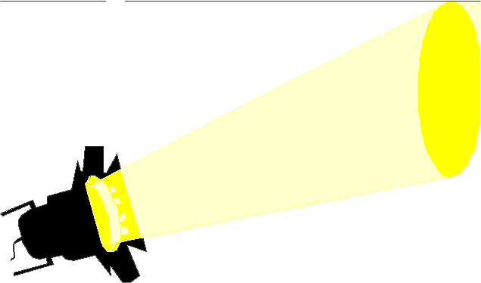
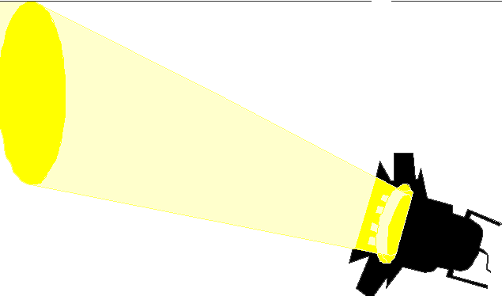
Cambridge Model: “Righting” the Pyramid
Context Matters!
System related influences
Performance
Individual related influences
Competence
Work-based assessment has to be the primary focus of our assessment programs
Rethans, Norcini, et al, 2002
Notes:
If the goal is performance then need to workplace assessment. When you get to top this is where you need to do all of the meaninfgul assessment. Competence can do with MCQ but doesn’t translate to performance- we have robust MCQ, but we don’t have WBA assessments
And just because know does mean you do
Competency based assessments were defined as what doctors do in testing situations- performance based assessment defined as measure of what doctors do in practice. Cambridge flips millers- competence is first three levels of miller- greater focus on performance
Interaction of person and system

Slide 16
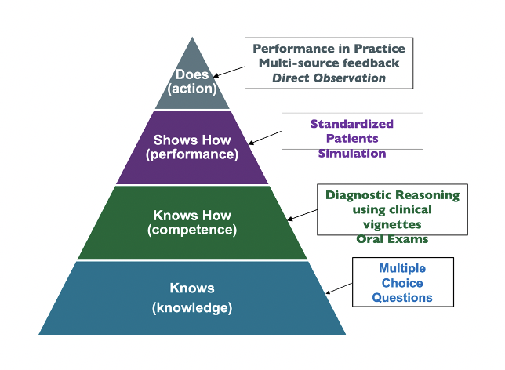
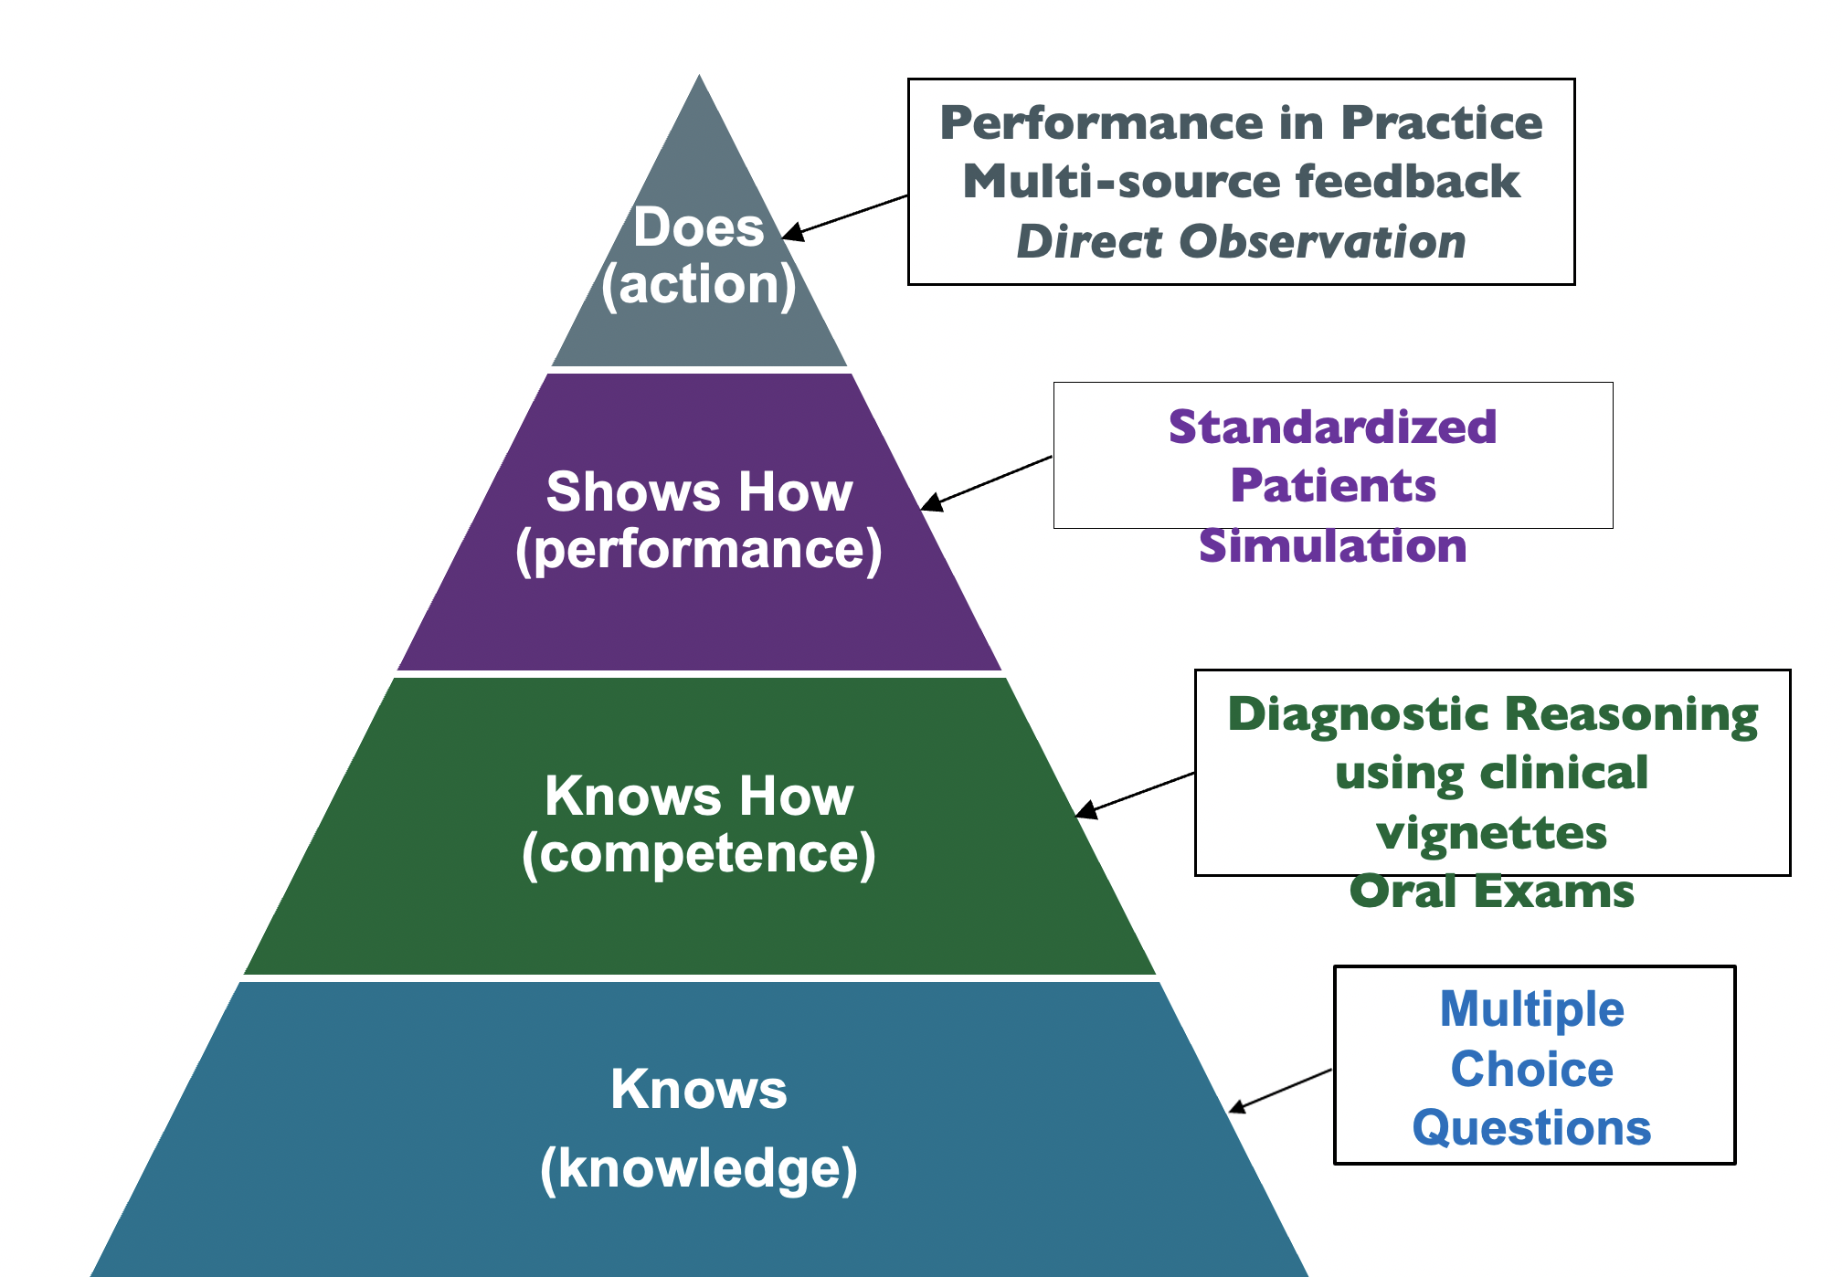
Small group exercise #1:
Which assessment methods do you use to assess:
Patient Care (PC)
Medical Knowledge (MK)
Professionalism (PROF)
Where do they fit on Miller’s pyramid?

Slide 17
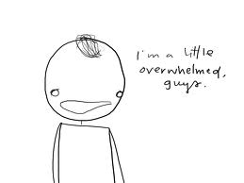
How to Choose?

Slide 18
Types of Assessment
Four major types
Written tests
Oral exams
Performance tests
Clinical (work-based) observations
PLUS
Narrative assessment
Portfolios
Assessment in Health Professions Education, 2nd ed.

Slide 19
Written tests- Pros/Cons
Pros
Most often used to test medical knowledge (MK), but consider...other core competencies e.g., systems-based practice (SBP) and practice-based learning & improvement (PBLI)
Good for testing medical knowledge. Gets at the "knows" & "knows how" of Miller's pyramid
Cons
Test questions are hard to write!

Slide 20
Oral Exams
Oral questioning in various formats
Usually face-to-face
Formal/high-stakes
Informal – bedside, chart-stimulated recall
Used to assess: e.g.,
Clinical reasoning
Judgement/ethical dilemmas
Communication
Assessment in Health Professions Education, 2nd ed.

Slide 21
Oral exams – Pros/Cons
Pros
Can address various levels of Miller’s pyramid
Knows how/Shows how/Does
Chart-stimulated recall (CSR)
Cons
Hard to test (sample) a lot of content
May require a lot of training
Inappropriate/flawed questions
Stereotypes
Language challenges
Assessment in Health Professions Education, 2nd ed.

Slide 22
Performance Tests
Tests designed to test clinical skills ”in vitro” i.e., “the task is contrived for the purpose of the examination and explicitly invites the examinee to demonstrate the behavior to be assessed.”
Simulation-based testing – standardized patients, objective structured clinical examination (OSCE), testing mannequins, virtual reality simulators etc.
Yudkowski R. Assessment in Health Professions Education, 2nd ed.

Slide 23
Performance Testing – Pros/Cons
Pros
Gets at the "shows how" of Miller's pyramid
Ability to test complex skills in a controlled setting
Cons
Can be expensive
Lots of logistics
Lot of training – standardized patients, faculty
Standard setting

Slide 24
Clinical (Work-Based) Assessments
Observational, in actual work settings
Use of rating forms, checklists, narrative assessments
Variety of raters
Informal to Formal e.g.,
Mini-CEX
SEGUE
End-of-rotation assessments
Multisource feedback
Practical Guide to the Assessment of Clinical Competence, 3rd ed.

Slide 25
Direct Observation (DO)
Defined as observing a learner performing a clinical skill, engaging with care team, teaching or leading for the purpose of assessment
Rationale:
Clinical skills are vital but often lacking
DO is fundamental to deliberate practice & feedback
A requirement of accrediting bodies
DO is a key part of supervision to ensure optimal patient care
Practical Guide to the Assessment of Clinical Competence, 3rd ed.

Slide 26
Direct Observation- Pros/Cons
Pros
“Does” level on Miller’s pyramid
Opportunities for feedback
Cons
Need faculty development
frame of reference
inferences
“The assessment instrument is the faculty, not the tool”
Kogan J, Holmboe E. Practical Guide to the Assessment of Clinical Competence, 3rd ed.

Slide 27
Multisource Feedback (MSF)
A questionnaire-based assessment tool
Occurs in 4 stages
Data is collected from those who work with the trainee
Data is aggregated (anonymity)
Include a self-assessment
Trainee meets with a facilitator to review the data and create an individualized learning plan
Primarily for formative assessment
Chapter 12, Practical Guide to the Assessment of Clinical Competence, 3rd ed.

Slide 28
MSF- Pros/Cons
Pros
Used for a broad range or learners (UME to CME)
Provides data from various perspectives - which may reduce unfairness
Built-in self-reflection
Cons
Lots of data/raters to manage
Make sure there is buy-in
Harder to do in settings with few people (small programs)
Chapter 12, Practical Guide to the Assessment of Clinical Competence, 3rd ed.

Slide 29
Narrative Assessment
Qualitative description of a trainee's clinical ability
Often used in conjunction with other assessment methods
Promotes assessment for learning BUT can be used in aggregate to support summative decisions
Descriptions should be detailed/rich
Focused on observed behaviors, not inferences
Include strengths & weakness - with specific examples

Slide 30
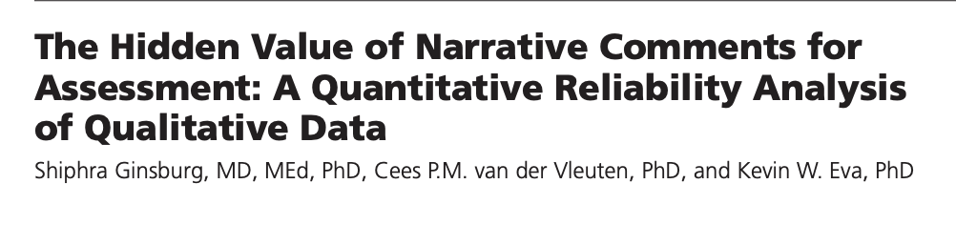
Narrative Assessments- Pros/Cons
Pros
Makes sense of the quantitative assessment data
Cons
Manage trainee expectations
Faculty development
Plan for data analysis

Slide 31

Reliability and Validity Simplified
Not reliable
Not valid
Reliable
Not valid
Reliable Valid
Kogan J, ACGME
Notes:
Reliable- provides clear, consistent information
Validity: is the tool measuring what you think it is measuring- remember validity is context dependent

Slide 32
Utility Index
Utility = V x R x A x EI x CE/Context
Where:
V = validity
R = reliability
A = acceptability
E = educational impact
C = cost effectiveness
Van Der Vleuten C, Adv Health Sci Educ Theory Pract. 1996
Notes:
If any one of these is 0, then there is no utility (anything multiplied by 0 is equal to 0)
Validity = is the tool measuring what you think it is measuring? (Is it a valid tool to measure x?)
Reliability = consistency (over time, across judges, across content)
Acceptability = do faculty using it find it acceptable (75-question form; probably not)
Educational impact = does it motivate education?
Cost effectiveness = resource effectiveness; how much does it cost (money, time, resources, etc.) to do?
CONTEXT MATTERS

Slide 33
Educational Impact
Educational Effect
“The assessment motivates those who take it to prepare in a fashion that has educational benefit.”
Catalytic Effect
“The assessment provides results and feedback in a fashion that creates, enhances, and supports education; it drives future learning forward.”
Norcini J et al. Med Teach 2011;33:206-14

Slide 34
Small group exercise #2:
Which assessment methods do you use to assess:
Interpersonal & Communication Skills (ICS)
Practice-Based Learning & Improvement (PBLI)
Systems-Based Practice (SBP)
Where do they fit on Miller’s pyramid?
Utility Index?

Slide 35
Wrap Up
Session Objectives
Differentiate key features of common types of assessment methods
Discuss criteria/frameworks to assist in choosing assessment methods
Assessment strategy
? Fit for purpose
? What levels of performance are you assessing
(Miller’s pyramid)

Slide 36
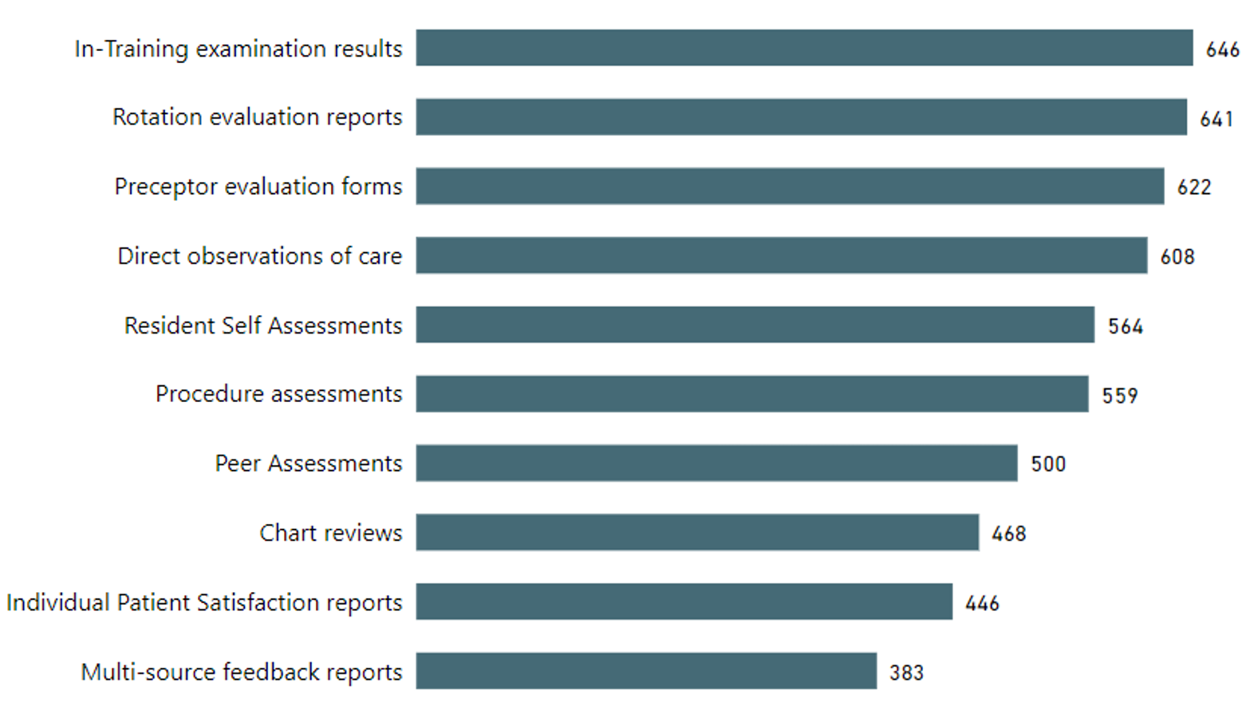
What assessments are residencies using? Attestation Survey: >50% residencies use
655 residencies

Slide 37
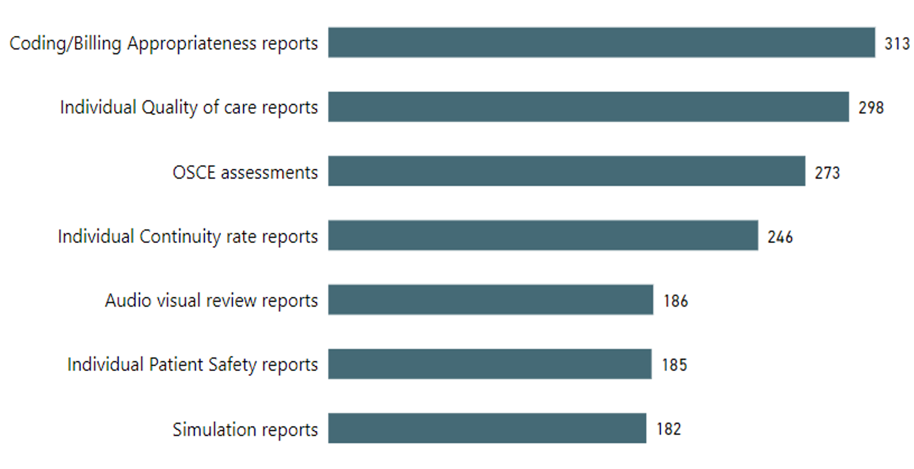
What assessments are residencies using? Attestation Survey: 25-50% residencies…
655 Residencies

Slide 38
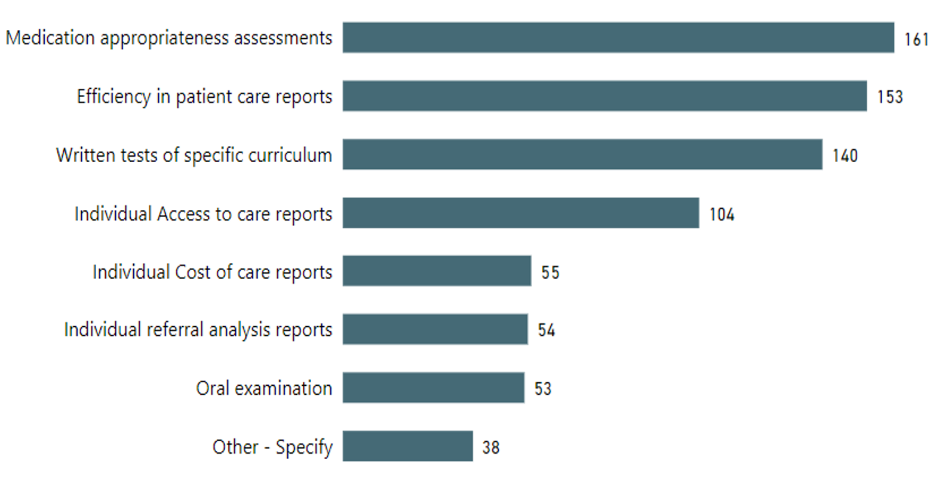
What assessments are residencies using? Attestation Survey: <25%
655 residencies

Slide 39
Multi-Source Feedback: Potential Raters
Patients
Trainees
Patient Families
Physician Faculty
Peers
RESIDENT
SELF
Medical Asst.
Social workers
Other health care providers...
Consultants
Nurses
Notes:
39

Slide 40
MSF Essential for…
Assessing interpersonal skills and communication, professionalism, and systems-based practice
ICS
Patient and family centered communication
Interprofessional and team communication
Communication within healthcare systems
Professionalism
Professional behavior and ethical Principles
Accountability/Conscientiousness
Systems-based practice
System navigation for patient centered care

Slide 41
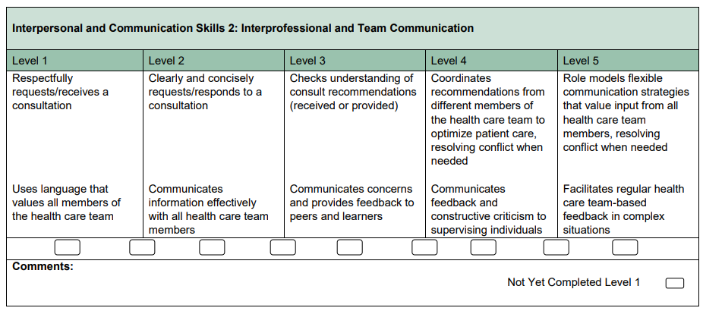
FM ICS2 Subcompetency

Slide 42
MSF Evidence
Systematic Review 2014:
Reviewed 43 articles
MSF effective method in providing feedback to physicians across range of specialties
Conclusions
In general, assessment of physician performance was based on the completion of the MSF instruments by 8 medical colleagues, 8 coworkers, and 25 patients to achieve adequate reliability and generalizability coefficients of α ≥ 0.90 and Ep2 ≥ 0.80, respectively.
Donnon T, et. al. The Reliability, Validity, and Feasibility of Multisource Feedback Physician Assessment: A Systematic Review. Acad Med. 2014.

Slide 43
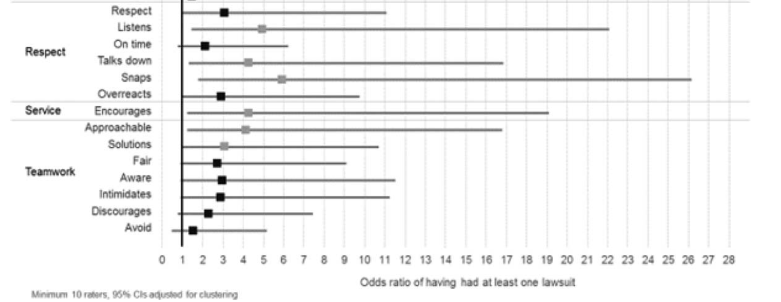
MSF and Malpractice
Harvard associative study of 264 surgeons and malpractice claims
Lagoo J, et. al. Multisource Evaluation of Surgeon Behavior is Associated with Malpractice Claims. Ann Surg, 2018; online first. DOI: 10.1097/SLA.0000000000002742
Notes:
From 2012-2013
Surgeon behavior, as assessed by 360-degree review, is associated with malpractice claims. These findings highlight the importance of teamwork and communication in exposure to malpractice. Although the nature of malpractice claims is complex and multifactorial, the identification and modification of negative physician behaviors may mitigate malpractice risk and ultimately result in the improved quality of patient care.--from Conclusions

Slide 44
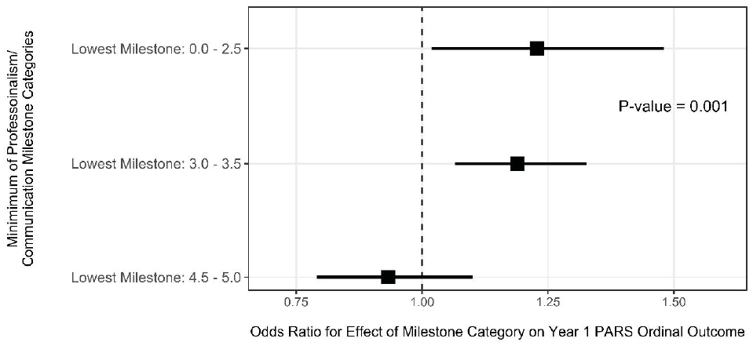
Adjusted Effect of Minimum Professionalism/Communication Milestone Category on PARS Year 1 Index Score Category
Reference:
Milestone Rating = 4.0
Han M, Hamstra SJ, Hogan SO, et. al. Trainee Physician Milestone Ratings and Patient Complaints in Early Post-Training Practice. JAMA NteW Open. 2023.
Notes:
PARS = Patient Advocacy Reporting System
In this study, trainees with low Milestone ratings in P and ICS near the end of residency were at increased risk for patient complaints in their early posttraining independent physician practice. Trainees with lower Milestone ratings in P and ICS may need more support during graduate medical education training or in the early part of their posttraining practice career—From Study Conclusions

Slide 45
Peers
Peer assessment is clearly a valuable feedback approach
Key issues in peer assessment
Assessment of task versus global rating
Performance of specific actions versus “quality” of those actions
Does the peer have the requisite experience and competency to make the judgments asked by the tool?
Ability to make meaningful distinctions
Notes:
Identifiable task or entrustable activity
Binary or qualifiers
Should an intern evaluate a PGY-3?

Slide 46
Benefits to Learners
Multiple studies in medical education now highlight the value of MSF for learners when the MSF is properly implemented.
Nurses and other health professionals provide more feedback on collaboration (e.g. interprofessional teamwork), communication, and leadership than physician faculty
Patient and family (e.g. pediatric care) can provide valuable feedback on communication and professionalism
In several studies, residents used this feedback to make changes in their clinical practice
Notes:
Regarding benefits to learners, there are a number of studies that have shown or highlighted the value of MSF for learners when the multi source feedback processes is properly implemented. Studies have shown that nurses and other health professionals provide more feedback on collaboration, interprofessional teamwork, communication, and leadership skills that physician faculty.
Patients and families, particularly in pediatric care, can provide valuable feedback on communication and professionalism skills.
Perhaps most important, several studies have shown residents value and do use the feedback to make changes in their own clinical practice.

Slide 47
Nurses
Nurses and other health professionals ratings often do not correlate with faculty ratings and other measures
Ogunyemi, et. al. (2009)
Residents assessed on communication with patients, interactions with peers, and professionalism
Weak correlations occurred between nursing and faculty evaluations (r = 0.065-0.119, P < .001).
Weak negative correlations between nursing evaluations and standard medical examination scores (r = -0.08 to -0.10, P < .001).

Slide 48
Key Steps in Implementing MSF
Communicate | Assess program readiness, including learners Identify who will lead the effort Determine intended use (formative recommended) Identify the constructs/domains and competencies of interest Establish frequency of administration Determine instrument delivery methods
Lockyer J. Practical Guide to the Evaluation of Clinical Competence. 2018
Notes:
Jocelyn Lockyer, a research leader in implementing MSF in Canada, recommends these key steps in implementing multisource feedback. The first step is crucial – you will need to assess program readiness to start an MSF process, and that should involve the learners throughout this process using the mindset of co-production. View your learners as partners in the implementation process. This will not only help with transparency and buy-in, but learners can also help to improve the process and value of MSF iteratively over time.
While you can certainly create your own MSF instrument, this requires substantial work and we’d recommend you consider first using an existing instrument.
Implement with PGY-1 learners, not PGY-3 learners about to graduate

Slide 49
Key Steps in Implementing MSF
Communicate | Test and review instruments with key stakeholders Provide basic training and orientation on the instrument. Continuously evaluate and modify program
Lockyer J. Practical Guide to the Evaluation of Clinical Competence. 2018
Notes:
Once you have identified, adapted, or created an MSF instrument, you should first test the instrument with stakeholders who will complete the instrument and include learners who will receive the data to assess how the survey items are understood and interpreted. Some training, even if only a brief overview, for the raters is preferable and lessons gleaned from the testing phase can provide insights that can be shared as part of the preparation training. This orientation and training should focus on instrument purpose, items, and how results will be used.
You will likely want to pilot the tool with a limited number of learners first before wider dissemination.
Let’s now look at a few existing MSF tools that may be of interest.

Slide 50
Learners and MSF process
Ensure…
Residents and/or fellows should also receive orientation on purpose, items, and especially how results will be used
Individualized learning plans, whether results presented at CCC, etc.
Training on how to use the results for their professional development
Feedback is provided in person and through conversation with a trusted faculty member or mentor
Essential for “sense-making” of results
Notes:
An example of how not to do this: providing patient feedback the week before a PGY-3 graduates
I cannot emphasize enough the importance of discussing with learners

Slide 51
Review of Existing MSF Instruments
Residency Management System
Interprofessional Professionalism Collaborative
Generic patient satisfaction surveys
Teamwork Effectiveness Assessment Module (TEAM)
Open access module available from ACGME
Notes:
Australia RCGP
https://cfepsurveys.com.au/our-surveys/multi-source-feedback/#
New Innovations has shared evals

Slide 52
Interprofessional Professionalism
Interprofessional Professionalism Collaborative
MSF tool to measure IPP
Website: http://www.interprofessionalprofessionalism.org/
Website contains three videos for faculty development and teaching
26 items with narrative comments
Frost JS, Hammer DP, Nunez LM, et.al. The intersection of professionalism and interprofessional care: development and initial testing of the interprofessional professionalism assessment (IPA). J Interprof Care. 2018 Sep 24:1-14.

Slide 53
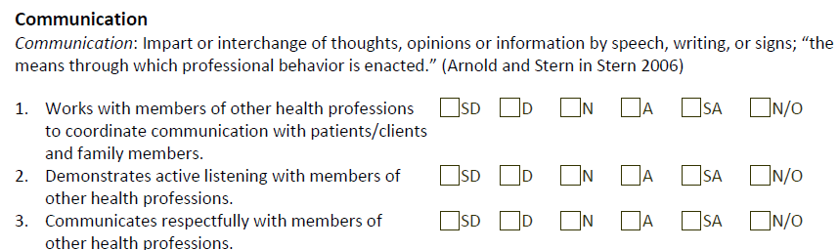
Interprofessional Professionalism Assessment

Slide 54
Small Group Exercise
Where and how do you use multi-source feedback in your program?
If using MSF, what instrument are you using?
What members of the healthcare “team” are asked to assess the trainee?

Slide 55
Assessing Patient Experience
Notes:
Switching gears to think about how what we measure affects the patient experience, who we are ultimately accountable to

Slide 56
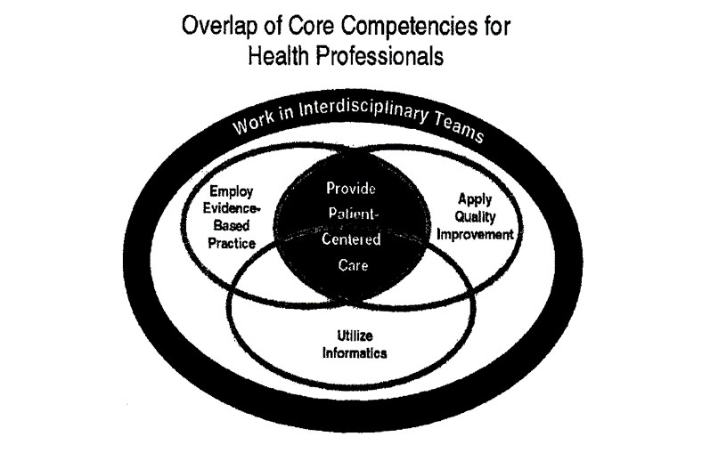
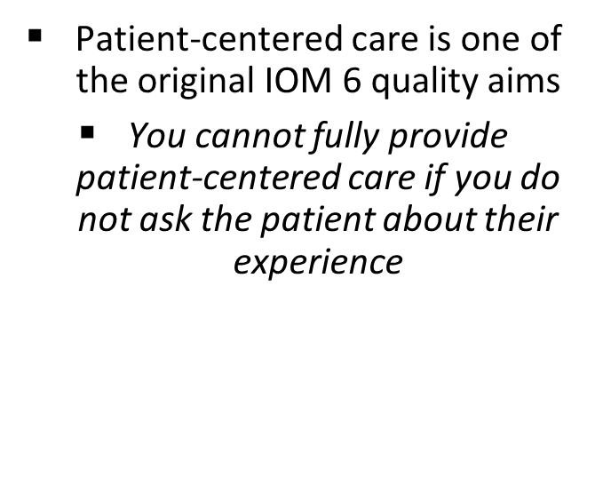
Patient Experience

Slide 57
Link Between Communication and Outcomes
Immediate Outcomes
Intermediate Outcomes
Health Outcomes
Increased patient knowledge
Increased patient self-efficacy
Better IDM
Increased adherence
Improved self-care
Improved biologic outcomes
Improved QoL and well-being
Improved survival
Reduce costs
Reduced disparities
Improved PC communication behavior during the patient encounter
Teach PC* Communication Skills
*PC = patient-centered
Levinson W, Lesser CS, Epstein RM. Developing Physician Communication Skills for Patient-centered care. Health Affairs. 2010; 29: 1310-18.

Slide 58
Available Patient Survey Approaches
AHRQ family of CAHPS surveys
Target specific types and location of care
Available at: CAHPS Patient Experience Surveys and Guidance | Agency for Healthcare Research and Quality (ahrq.gov) and CMS website
Press-Ganey, Picker (commercial entities)
Patient reported outcome measures (PROMs)
Functional status
Clinimetric approach
Open ended questions at end of visit

Slide 59
Small Group Exercise
Do you use patient experience surveys (PES) in your program?
If yes, where and how?
If no, where could you use patient experience surveys?

Slide 60
Self-Assessment

Slide 61
Self-Assessment Skills
Systematic review (Davis, JAMA, 2006)
Accuracy of self-assessment compared to external observation
17 studies included; 20 total comparisons
13 demonstrated little, no or inverse relationship
Worst accuracy of self-assessment among least skilled physicians

Slide 62
Kruger-Dunning Effect
Unskilled and Unaware of It (1999)
“Unskilled individuals suffer a dual burden: not only do these people reach erroneous conclusions and make unfortunate choices, but their incompetence robs them of the metacognitive ability to realize it”

Slide 63

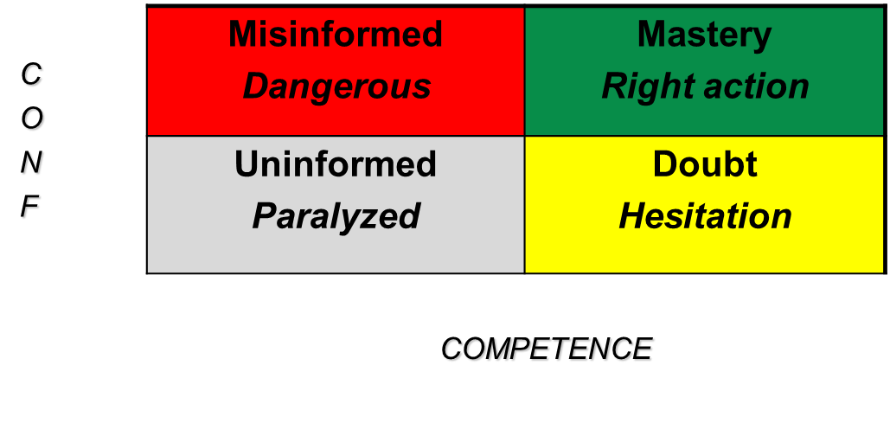
Confidence versus Competence

Slide 64
Informed Self Assessment
The literature is clear – cannot perform effective or accurate self-assessment alone or in isolation
Eva and Regher
“Self-directed assessment seeking”
Sargeant
Informed self-assessment essential but complex process that requires support and coaching of the learner
Individualized learning plans (ILPs) important component

Slide 65
Reflective Practice
Finlay: Reflective Practice is the process of critically considering one's own professional practice during or after events in order to review one's values and to understand the emotions and reasons behind one’s action and decisions and the effect of those actions and decisions on others
Shoen: reflection-in-action and reflection-on-action
Slide courtesy of Gail Armstrong

Slide 66
Reflective Practice (RP) – Key Elements
Often activated by a need
Triggered by complexity, a disruption in usual practice, or a non-routine situations
Interpretations are influenced by beliefs, values, assumptions, emotions, previous experiences – our “frame of reference”
Reflective practice should lead us to question our beliefs, values, assumptions
The purpose is to improve our performance
Slide adapted from Tom Viggiano

Slide 67
Milestones Learning Cycle
Gain/Refine Understanding and Apply Milestones in Practice
Complete/Implement Individualized Learning Plan
Perform Self-assessment (SA) Prior to CCC
Compare/Contrast SA with CCC Milestone Judgments

Slide 68
Questions

