Slide 1
Coaching in Residency Education
From Assessment to Development
Notes:
Welcome participants.
Frame coaching as a developmental skill, not remediation.
Timing: 2 minutes.
Literature anchor: Palamara et al. (JGME 2015) on professional development coaching.

Slide 2
Session Objectives
• Define coaching
• Distinguish coaching vs mentoring/advising
• Practice core coaching skills
Notes:
Review objectives.
Set expectation this is interactive.
Timing: 2 minutes.

Slide 3

Why Coaching?
Essential component of CBME
Notes:
Frame the problem: CBME and ILPs require ownership; coaching helps fill the gap left by evaluation-heavy systems.

Slide 4
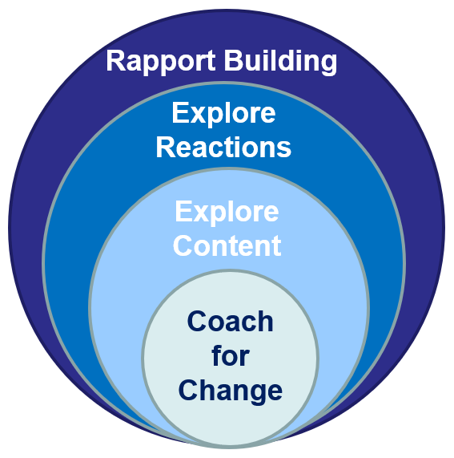
Philosophical Principles of CCF
  Rich in feedback/coaching individualized to the learner and grounded in the desired competencies.
  Provides rich and diverse learning experiences, steeped in clinical practice where learners can stay as long as required
Van Melle E, et. al. A Core Components Framework for Evaluating Implementation of Competency-Based Medical Education Programs. Acad Med. 2019 Jul;94(7):1002-1009.

Slide 5
Core Components Framework: Theory and Evidence Informed
Sequenced Progressively | Tailored Learning Experiences | Competency-focused Instruction
Expertise Theory Entrustment Surface & Deep Approaches to Learning Mastery-based Learning | Situated Learning Deliberate Practice Self-regulated Learning Workplace-based Learning Professional Identity Formation | Zone of Proximal Dev’t Constructive Friction Learner-Centered Teaching Cognitive Apprenticeship Coaching Theory Growth Mindset

Slide 6

Deliberate Practice
“Individualized training activities especially designed by a coach or teacher to improve specific aspects of an individual's performance through repetition and successive refinement”
Requires a field that is reasonably well developed. Clear mental representations of the tasks of the field are essential.

Slide 7
UCSF Six Programmatic Principles
Coaching is essential to facilitate effective data use for reflection and learning planning
The program of assessment fosters self-regulated learning behaviors
Expert groups make summative decisions about grades and readiness for advancement
Hauer KE, O”Sullivan PS, Fitzhenry K, Boscardin C. Translating Theory into Practice: Implementing a Program of Assessment. Acad Med. 2018 Mar;93(3):444-450.

Slide 8
Feedback Foundations
Feedback
Coaching
Growth Mindset
Direct Observation

Slide 9
Why Coaching?
Residency = intense professional identity formation
Feedback alone is insufficient
Notes:
Discuss stress, burnout, identity formation.
Timing: 3 minutes.
Literature: Palamara; professional identity formation literature.

Slide 10
Feedback vs. Coaching
“While feedback cultivates insight into current performance, coaching focuses on promoting future improved performance”
Ekpenyong et al. JGME. 2021

Slide 11
What Is Coaching?
Partnership
Learner-driven goals
Reflection → action → reflection
Notes:
Define coaching clearly.
Emphasize partnership and learner ownership.
Timing: 3 minutes.
Literature: Branzetti et al. JGME 2023.

Slide 12
Feedback vs. Coaching
“Coaching moves a step beyond providing feedback and focuses upon identifying performance goals in response to feedback and developing plans to address them”
Ekpenyong et al. JGME. 2021

Slide 13

Advisor / Coach / Mentor
Notes:
? Share what do you think of when I say mentor, coach, advisor

Slide 14
Coaching vs Mentoring vs Advising
Advisor: program-driven
Mentor: role modeling
Coach: learner-centered
Notes:
Walk through distinctions.
Normalize faculty role confusion.
Timing: 3 minutes.
Literature: Branzetti; Armson.

Slide 15
Advising Session Domains & Topics
Academic Requirements
  Numbers! – New Innovations Scorecard
  Scholarly activity
  Performance Improvement activity
  Documentation timeliness
  Duty Hours adherence
  Supervision requirements
Career Development
  Fellowship planning
  Post-residency plans
  Elective choices
  Self-designed rotations
  CME plans
  CV creation and job search
Educational Progress
  Field Notes
  Attending-completed rotation evaluations
  Resident-completed rotation evaluations
  ISTE preparation & performance
  Milestone advancement
  Future: Upcoming rotations
Wellness
  Home-life stability
  Sleep deprivation
  Mood check
  Exercise
  Substance concerns
  Vacation planning

Slide 16
Advisor/Coach/Mentor
Advisor
    Usually assigned to advisee
    Rule enforcer / Information Provider
Mentor
    Chosen by the advisee, can have multiple
    Takes advisee “under wing”
    Similar career goals / passions
Coach

Slide 17
Interactive: Reflection
Think of a recent resident challenging meeting.
What was challenging about it?
Which role were you in most?
Notes:
Silent reflection 1 minute.
Optional pair share 2 minutes.
Timing: 3 minutes total.

Slide 18

Why Coaching?
The process of helping people focus, discover, and/or clarify:
  Where they are today
  Where they want to go
  How to get there
Coaching is a present-and-future focused tool for expanding others’ abilities
Egan’s skilled helper model
Notes:
Dave’s part
Explaining why we chose this for medical education
Pg. 9 Stealth Coaching by Rob Kramer, egans skilled coaching method

Slide 19
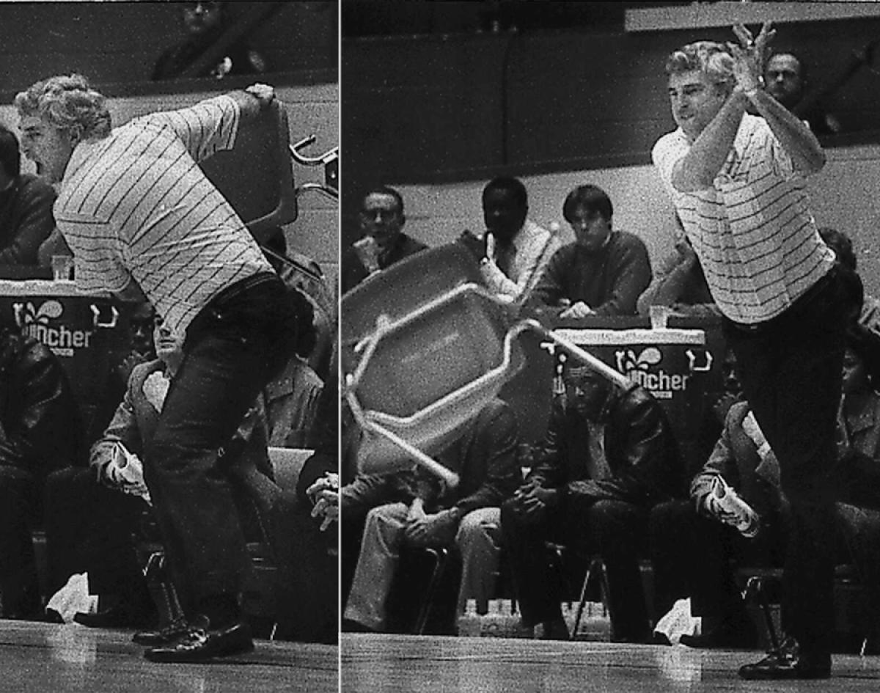
How to Coach

Slide 20
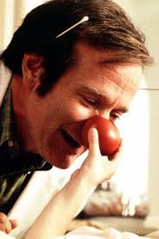

Intrinsic vs Extrinsic Motivation
Notes:
Think pair share. Personal experience of being intrinsic and extrinsic motivation. How did it feel? Did it work? Did it stick?

Slide 21
Egan’s Skilled Helper Model
STAGE 1: Current Scenario
1a: The story (What’s going on?)
STAGE 2: Preferred Scenario
2a: Possibilities (Ideally, What do I want instead?)
2b: Change agenda (SMART goals)
STAGE 3: Action Strategies
3a: Possible actions (How many ways are there?)
3b: Best fit strategies (What will work for me?)
1b: Blind spots (What’s really going on?)
1c: Leveraging (Focusing & Prioritizing)
2c: Commitment (Check goals are right)
3c: Plan (What next & when?)

Slide 22
Stage 1: Current Scenario
Safe place for the learner to share their story in their way. Often as important for them to hear themselves as it is for coach to hear.
1A: Expansive – telling their story
  Coach Skills: active listening, reflecting, paraphrasing, open ?s
1B: Challenging – encouraging clarity
  Coach Skills: differing perspectives, patterns & connections, should / ought, blind spots, ownership
1C: Focusing & Ordering – determining what matters
  Coach Skills: facilitating, prioritizing

Slide 23
Stage 2: Preferred Scenario
The most common pitfall is to skip this step. This changes perception of challenges to opportunities
2A: Creative – broadening horizons
  Coach Skills: Probing, brainstorming, imagination, patience
2B: Reality Check – defining SMART goals
  Coach Skills: Knowledge of landscape (internal & external)
2C: Moving Forward – testing realism
  Coach Skills: Checking of commitment, knowledge of costs / benefits

Slide 24
Stage 3: Action Strategies
The “how” stage. Describes what specific steps could be undertaken to lead to success
3A: More creative – breaking out of old habits
  Coach Skills: knowledge of successful strategies, brainstorming
3B: Focus on strategies – reality-checking plans
  Coach Skills: understanding of relationships, broad-viewpoint
3C: Moving to action – step by step planning
  Coach Skills: facilitating organization, letting go, confirming

Slide 25
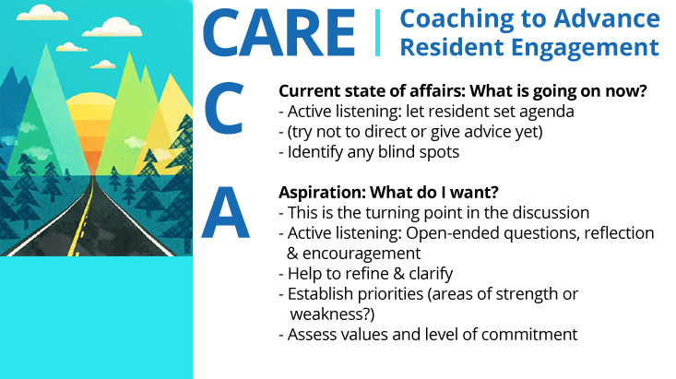

Slide 26
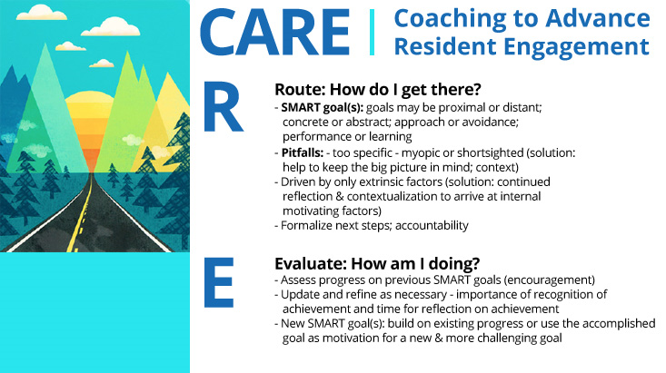

Slide 27
Coaching Questions That Work
What are you noticing?
What feels hardest?
What would progress look like?
Notes:
Model tone and pacing.
Timing: 3 minutes.

Slide 28
Educational Alliance
Trust
Psychological safety
Role clarity
Notes:
Introduce educational alliance concept.
Timing: 2 minutes.
Literature: mentoring/coaching environment reviews.

Slide 29
Common Coaching Pitfalls
Fixing too fast
Why-questions
Filling silence
Notes:
Normalize discomfort with silence.
Timing: 2 minutes.
Literature: coaching fundamentals.

Slide 30
CBME Needs Coaching
Outcomes-based
Self-directed learning
Reflection required
Notes:
Connect coaching to CBME.
Timing: 3 minutes.
Literature: Armson et al.

Slide 31
ILPs Without Coaching
Forms
Compliance
Missed opportunity
Notes:
Name the pain point faculty feel.
Timing: 2 minutes.

Slide 32
ILPs With Coaching
Insight
Ownership
Growth
Notes:
Reframe ILPs as developmental roadmaps.
Timing: 2 minutes.
Literature: Armson; AAFP ILP coaching work.

Slide 33
Using Data Without Becoming the Evaluator
Resident interprets first
Look for patterns, not points
Notes:
Key faculty anxiety slide.
Timing: 3 minutes.

Slide 34
Core Coaching Skills
Listening
Reflection
Goal setting
Notes:
Set up skill-building section.
Timing: 2 minutes.
Literature: Armson et al.

Slide 35
Coaching Micro-skills
Silence
Reframing
Affirmation
Notes:
Encourage practice mindset.
Timing: 2 minutes.

Slide 36
Role-Play Setup
Coach vs Advisor
Notes:
Explain scenario.
Assign roles.
Timing: 2 minutes.

Slide 37
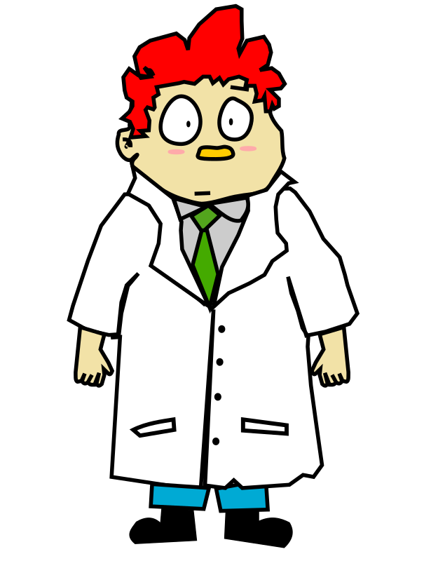
Case
“Sam”
Notes:
Sam is on his first inpatient medicine rotation of intern year. He is affable and well-liked by patients and their families. However, for the third time this week, you’ve had to push back rounding time because he wasn’t ready. When he does arrive, his white coat is wrinkled, his pockets are overflowing with EKGs, post-it notes, and printed copies of his H&Ps. His presentations are hard to follow, often straying from the SOAP format. He has had more duty hour violations than his peers, often arriving at the hospital at 4 AM and/or staying late into the night completing dictations.
Using the framework of the ACGME core competencies PLUS, turn to the person next to you and decide which competency or competencies seem to be the issue.
2 MINUTES*
This case was intended to be a straightforward deficit in time management and organization. However, and this may have come up with your partners, you can’t be completely sure that Sam does not have a mental health or substance abuse issue. The disorganization and disheveled appearance could indicate that. One way to differentiate is whether he is consistently disorganized (time mgmt/ organization problem) or inconsistently having trouble, which could correlate to stress, a mental health issue, or substance abuse.

Slide 38
Debrief Role-Play
What felt different?
What was harder?
Notes:
Group discussion.
Timing: 4 minutes.

Slide 39
What Coaching Looks Like in Real Life
15–30 min
Longitudinal
One priority
Notes:
Normalize feasibility.
Timing: 2 minutes.

Slide 40
Faculty Development Matters
Coaching is learned
Not intuitive
Notes:
Normalize need for practice.
Timing: 2 minutes.
Literature: Armson.

Slide 41
Key Takeaways
Developmental, not remedial
Resident-centered
Faculty skill
Notes:
Summarize.
Timing: 2 minutes.

Slide 42
Final Reflection
What would change if residents owned their growth?
Notes:
Invite reflection; pause for silence.

Slide 43
Try This Next Month
Ask before advising
Use one coaching question
Pause
Notes:
Concrete next steps.
Timing: 2 minutes.

Slide 44
Closing
Questions
Thank you
Notes:
Invite reflection and questions.
Timing: 2 minutes.

Slide 45
References
Palamara K, Kauffman C, Stone VE, Bazari H, Donelan K. Promoting success: A professional development coaching program for interns in medicine. J Grad Med Educ. 2015;7(4):630–637.
Armson H, Lockyer JM, Zetkulic M, Konings KD, Sargeant J. Identifying coaching skills to improve feedback use in postgraduate medical education. Med Educ. 2019;53:477–493.
Branzetti J, Love LM, Schulte EE. Coaching for clinician educators. J Grad Med Educ. 2023;15(2):261–262.
Marcdante K, Simpson D. Choosing when to advise, coach, or mentor. J Grad Med Educ. 2018;10(2):227–228.

Slide 46
References (cont.)
Bachkirova T, Kauffman C. The blind men and the elephant: Using criteria of universality and uniqueness in evaluating coaching definitions. Coaching Int J Theory Res Pract. 2009;2(2):95–105.
Pearson R, Garvin R. Coaching with the end in mind: Faculty skills in co-development of individualized learning plans. AAFP National Conference on Family Medicine Residents and Medical Students; 2024.
ACGME. ACGME Program Requirements for Graduate Medical Education in Family Medicine. Accreditation Council for Graduate Medical Education; 2023.
Newton W, Cagno CK, Hoekzema GS, Edje L. Core outcomes of residency training. Ann Fam Med. 2023;21(2):191–194.

Slide 47
References (cont.)
Vallerand RJ, Pelletier LG, Blais MR, et al: The Academic Motivation Scale: a measure of intrinsic, extrinsic, and amotivation in education. Educ Psychol Meas 1992; 52:1003–1017.
Orsini, C., et al. (2015). "Psychometric Validation of the Academic Motivation Scale in a Dental Student Sample." J Dent Educ 79(8): 971-981.
Nothnagle, M., Goldman, R., Quirk, M., Reis, S. Promoting Self-Directed Learning Skills in Residency: A Case Study in Program Development. Acad Med. 2010 Dec;85(12): 1874-9
George, P., Reis, S., Dobson, M., Nothnagle, M. Using a Learning Coach to Develop FM Resident’s Goal Setting and Reflection Skills. J Grad Med Educ. 2013 Jun; 5(2):289-93
Murad, M., Coto-Yglesias, F., Varkey, P., Prokop, L., Murad, A. The effectiveness of self-directed learning in health professions education: a systematic review. Med Educ. 2010 Nov;44(11):1057-68.
Kozakowski, Stanley M., Editor, Residency Program Solutions Criteria for Excellence, 9th Edition. AAFP. 2015.

